Slide 1

STOCK CRYPTO BOT
Receive Moving Averages on
Top Wall Street Indexes & Crypto
Via Daily Email and Text

Slide 2
STOCK CRYPTO BOT
End Product Plan
Goal: Create EMAIL/TEXT Bot to
Receive Moving Averages on Top Wall Street Indexes & Crypto
by sending Daily Email and Text
Visual: Email Graphs of Three line graphs
Representing S & P 500, NASDAQ, BTC and ETH
How: Create a table of current prices and changes from last update
Recommendation about trajectories
SMA/LMA display over graph
Graphs for other tickers maybe
Graph of past N days
Graph of trajectory (Lin Reg etc)

Slide 3
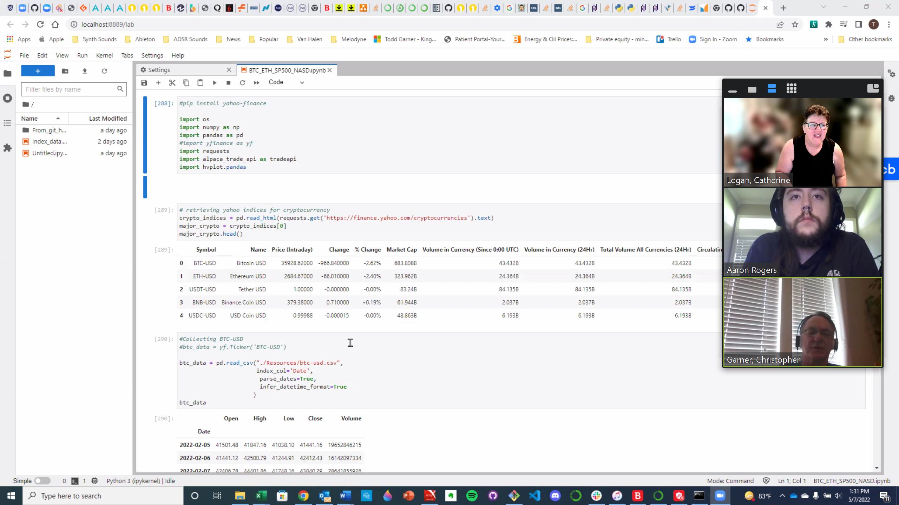
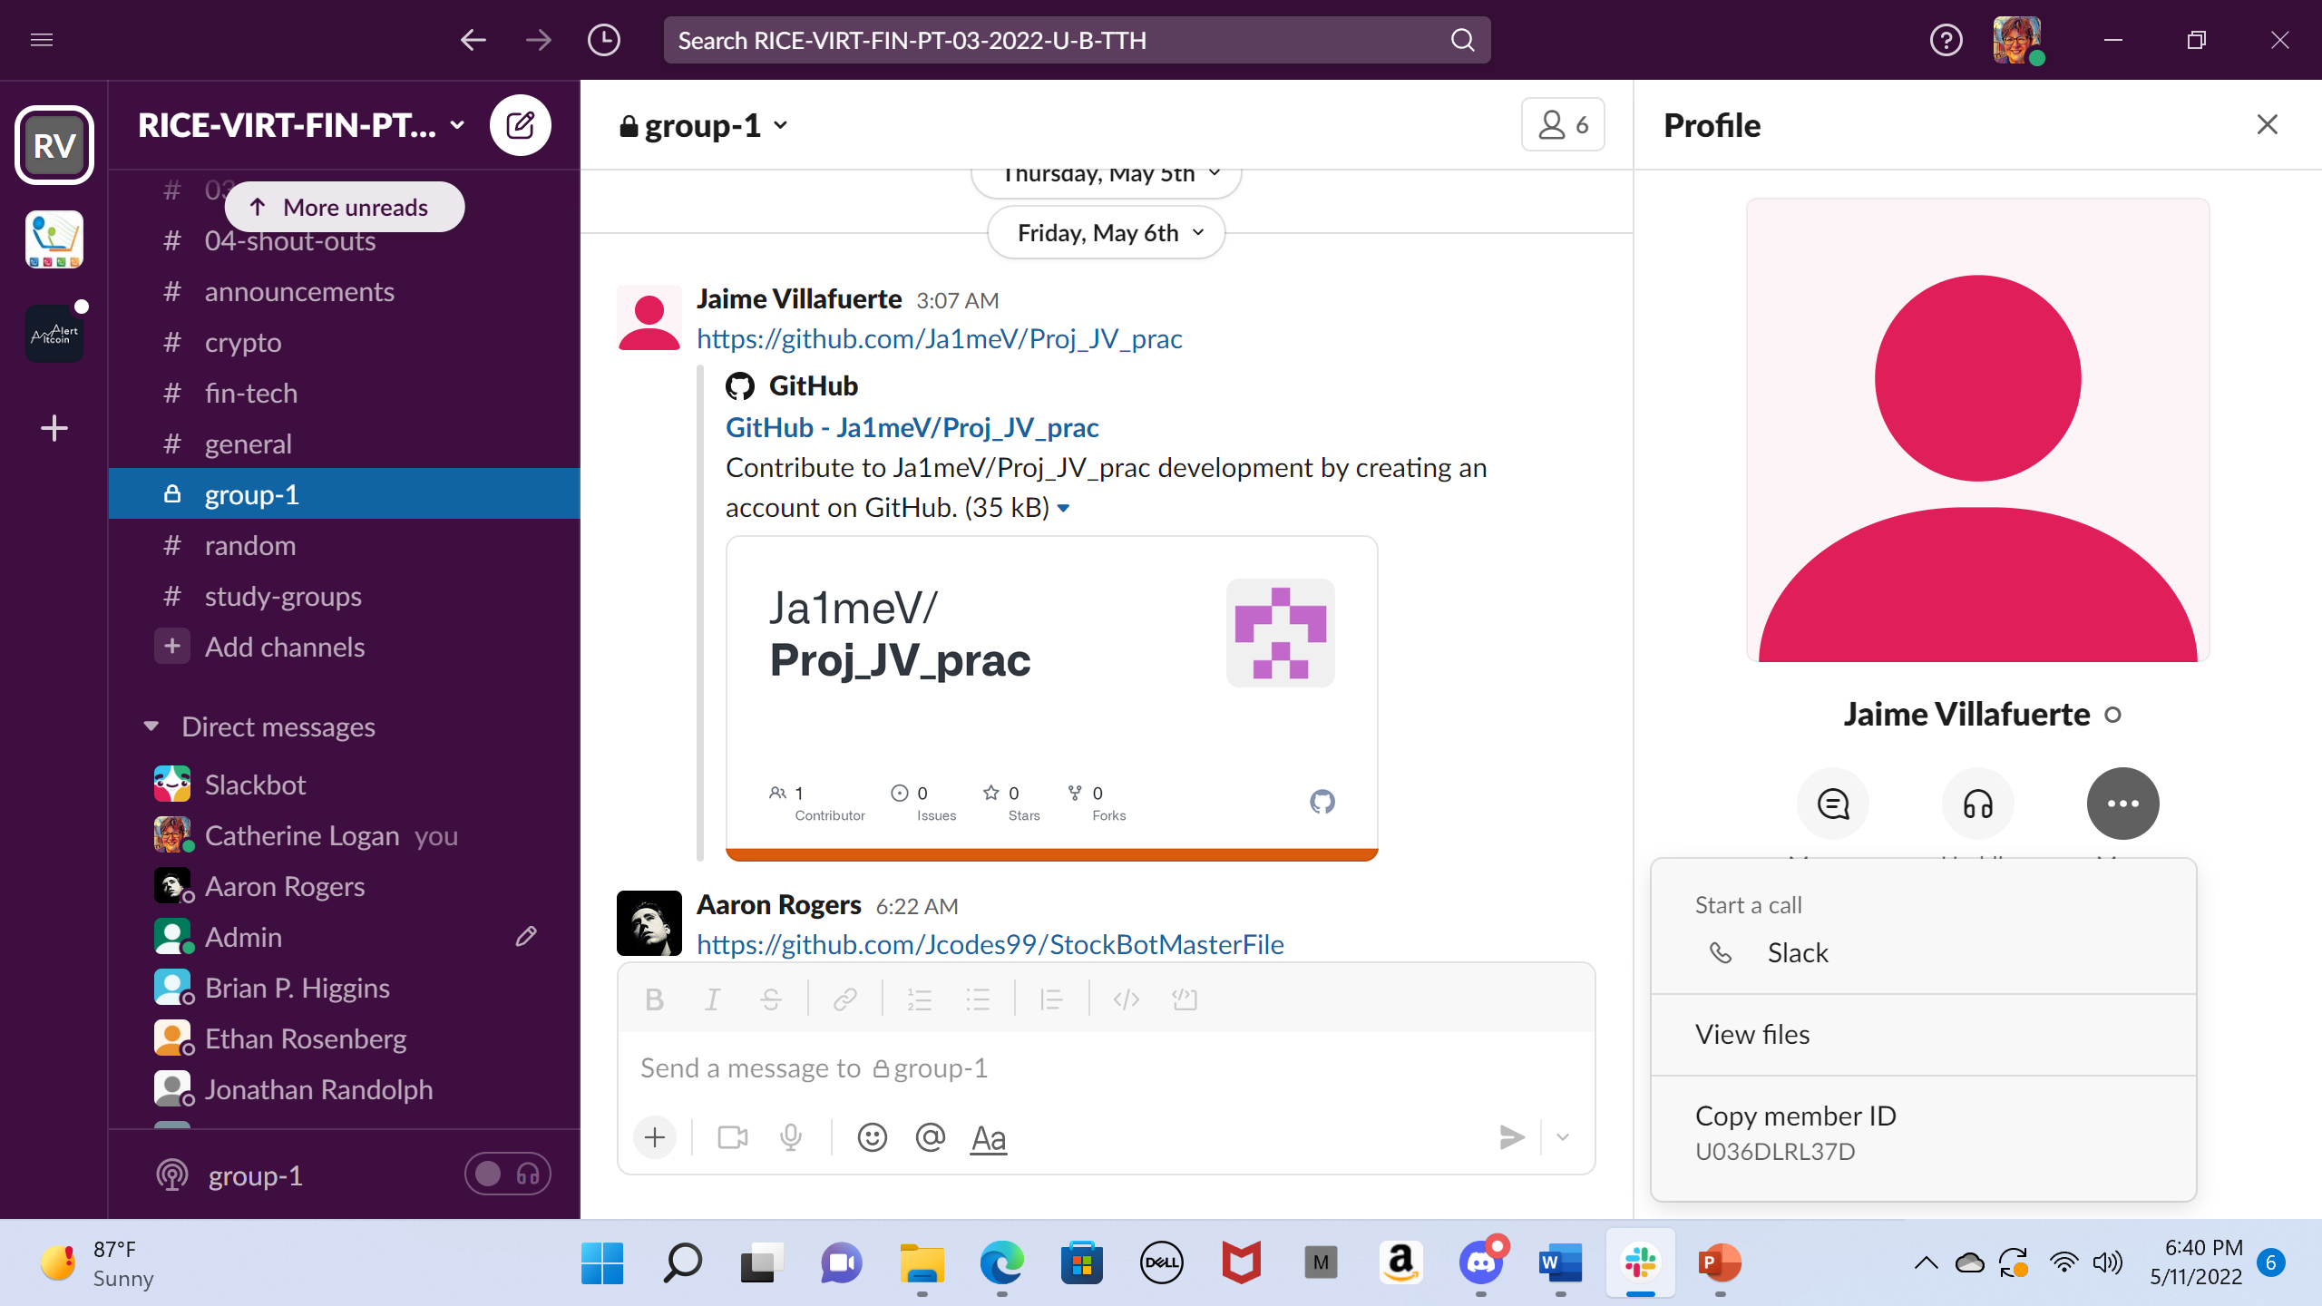
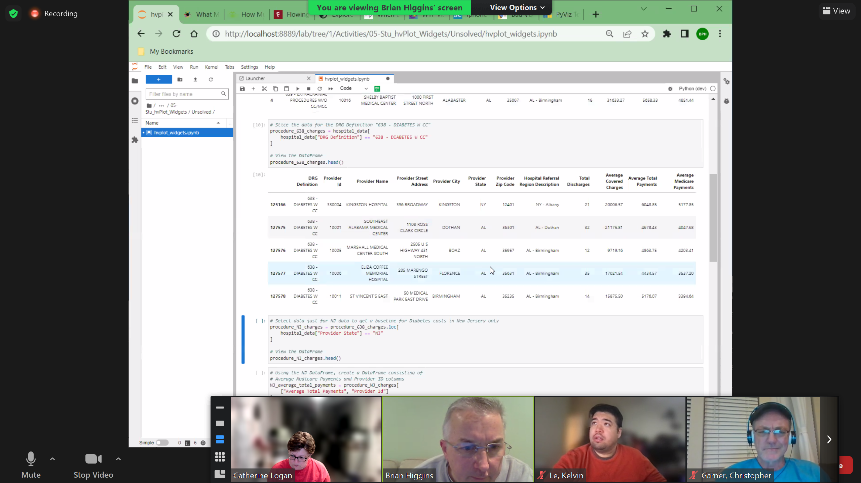
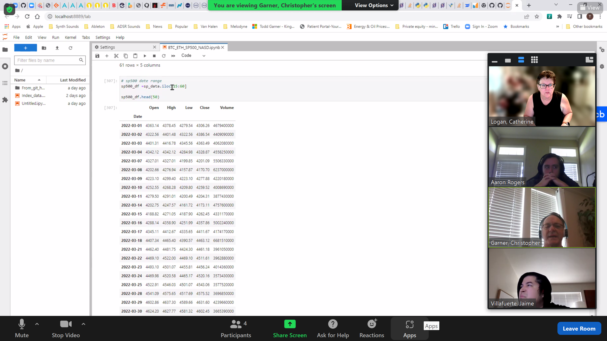
EACH MEMBER of GROUP I
STOCK CRYPTO BOT
Aaron Rodgers
Jaime Villafuerte
Todd
Garner
Catherine Logan

Slide 4
STOCK CRYPTO BOT
End Product Plan
There will be Four 4 Core parts to this project at its current stage (One for Each Member)
Yahoo Finance API
Panda Data Frames that use real time data to calculate the SMA/LMA of CRYPTO and STOCKs
Using Python to create Booleans that calculate the percent change of Stock/Crypto value
A SMS/Email API that forwards parts I, II and III to the user via EMAIL and Text

Slide 5
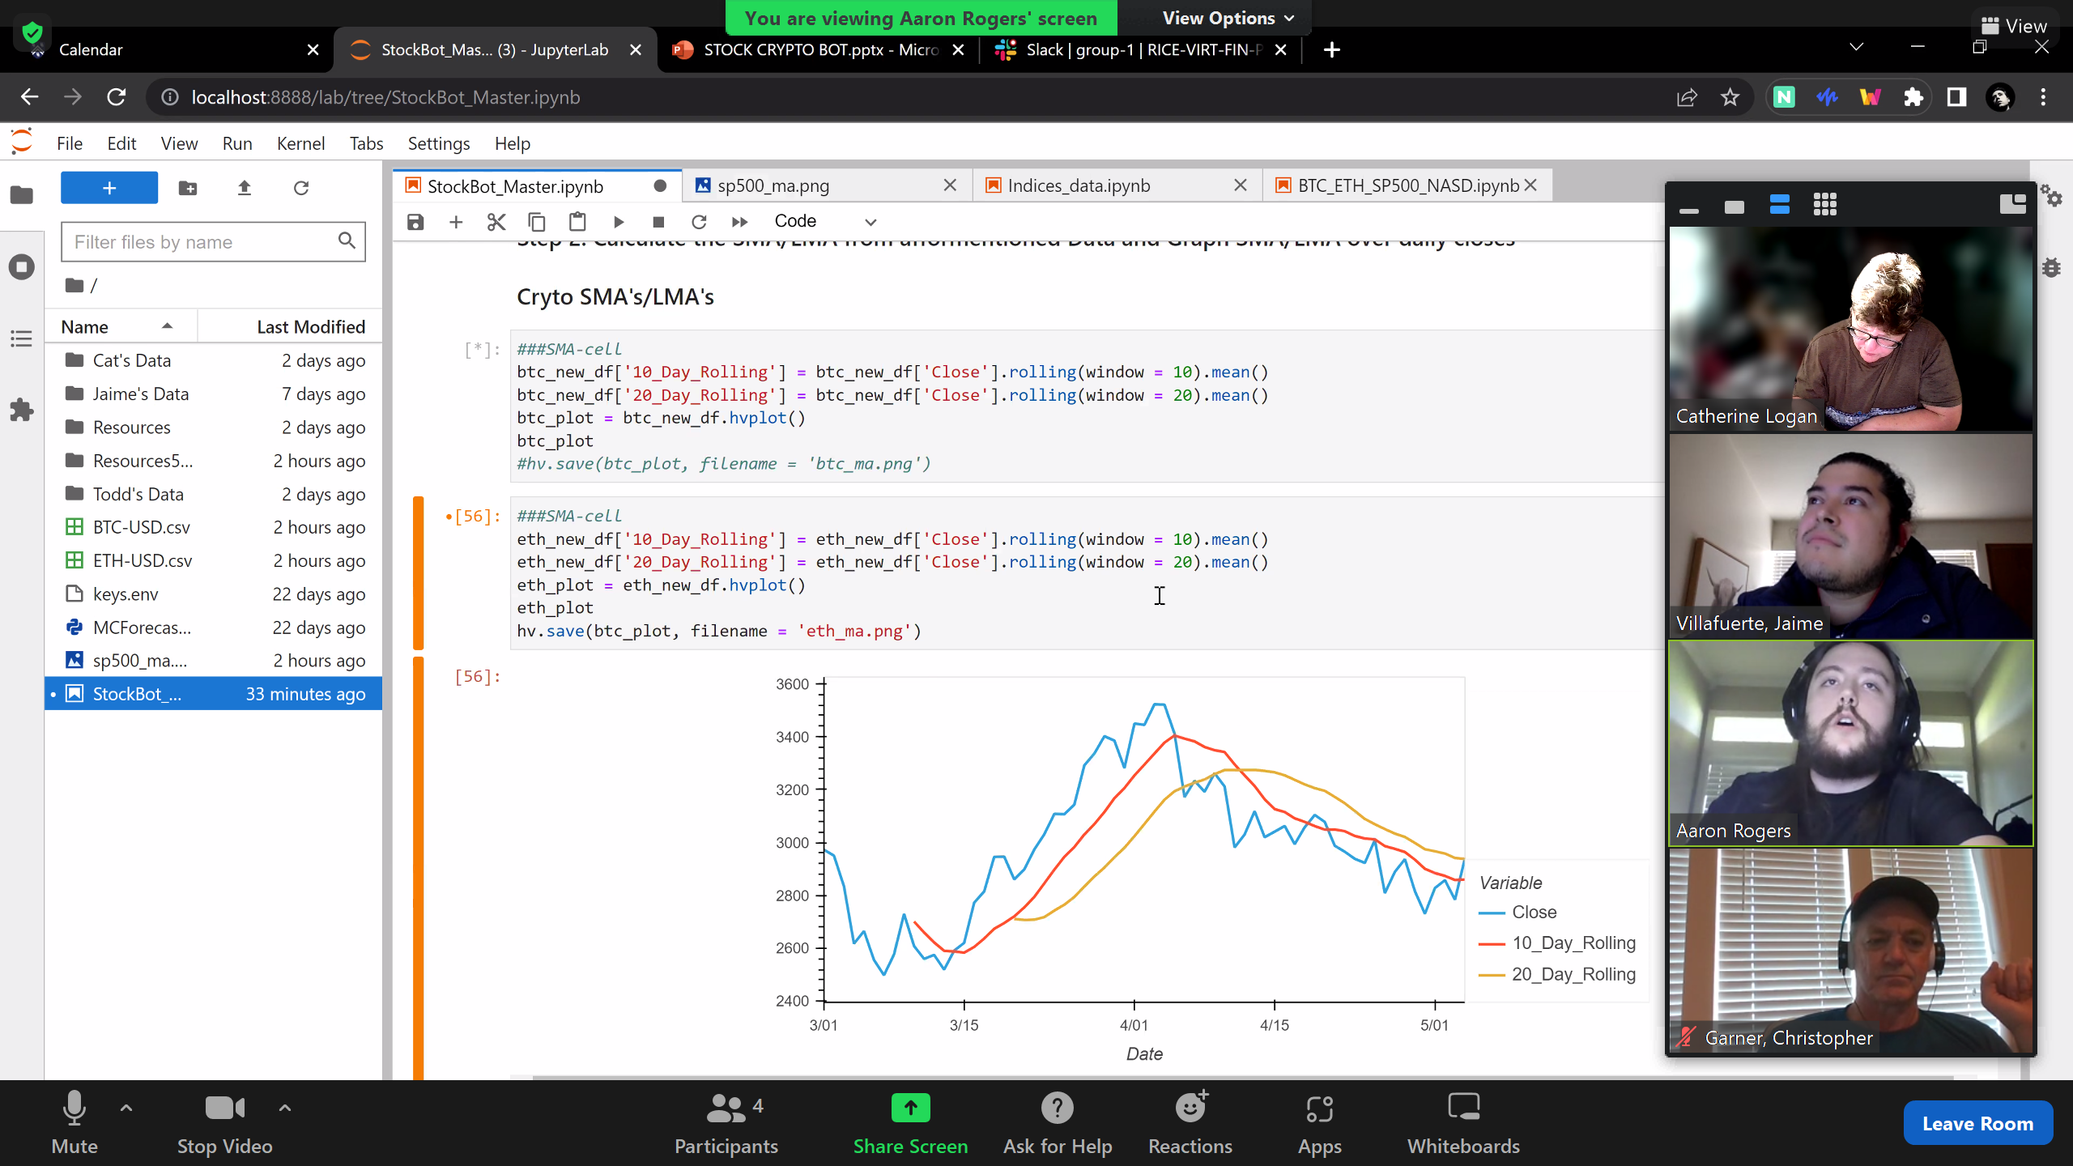
STOCK CRYPTO BOT
S & P 500

Slide 6
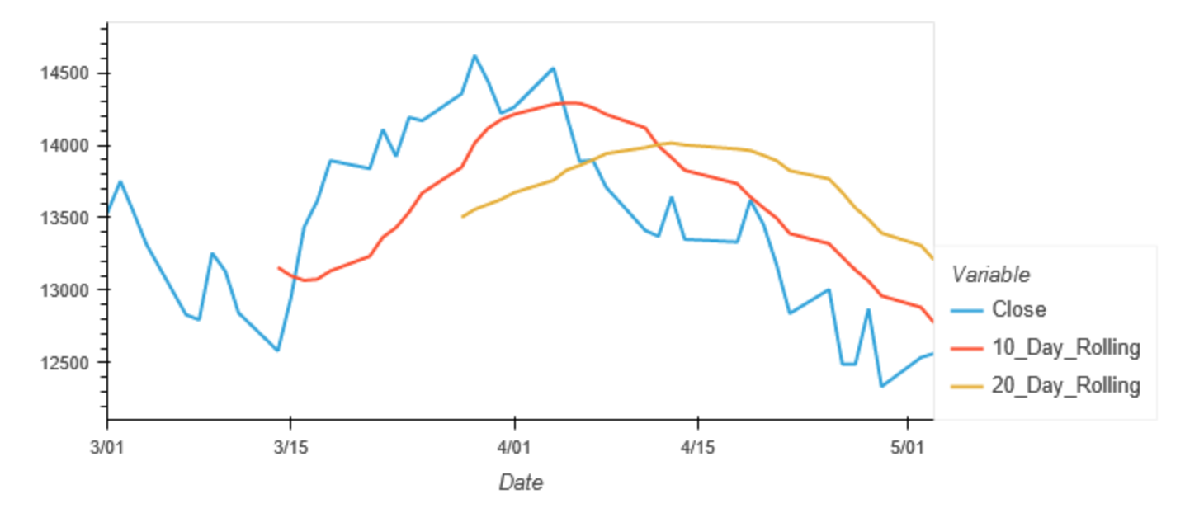
STOCK CRYPTO BOT
NASDAQ
Insert Graph

Slide 7
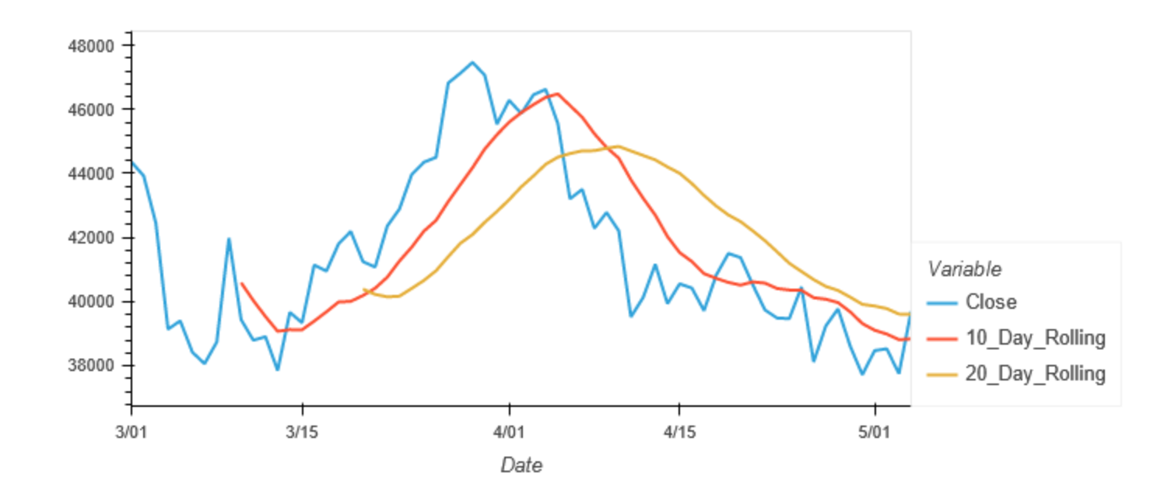
STOCK CRYPTO BOT
BITCOIN (BTC)

Slide 8
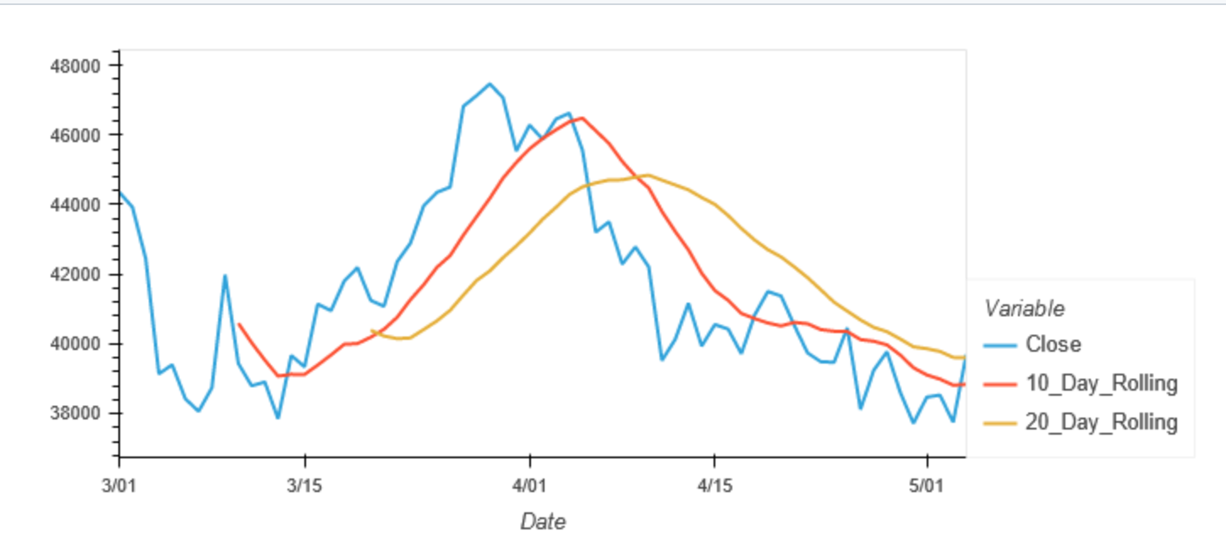
STOCK CRYPTO BOT
ETHERIUM (ETH)

Slide 9
STOCK CRYPTO BOT
Future Plans for Project I
Create code so the user can select their choice of variables to be able to visualize the results going up or down in the market.
This tool is to be utilize for retail trading

